Slide 1
CS 2212
Introduction to Software Engineering
Chapter 14 Pattern Based Design

Slide 2
Copyright Notice This Presentation and Its Associated Video Contain Copyright Material. This Presentation and Its Associated Video Are Provided for Teaching Purposes of CS2212 and Should Not Be Posted In Any External Site, Or Shared with. This Presentation and Its Associated Video Are Provided For Instructional Personal Use Only, and Only For The Purposes of the CS2212 Course.

Slide 3
Part 33
Architectural Styles
Programming can be fun, so can cryptography; however they should not be combined.
― Kreitzberg and Shneiderman.
Notes:
This lesson introduces the basic steps in a software engineering project at a high level.
In practice, steps often overlap.

Slide 4
Learning Objectives in this Part
To understand the Data Flow Architectural Style

Slide 5
Overview
Architectural styles and patterns
Data Flow
Call-and-return
Interacting processes
Data-oriented repository
Hierarchical
Other
Heterogeneous architectures

Slide 6
Data Flow Style
Components: Data Flow Components
Interfaces are input ports and output ports
Input ports read data; output ports write data
Computational model: read data from input ports, compute, write data to output ports
Connectors: Data Streams
Uni-directional
Usually asynchronous, buffered
Interfaces are reader and writer roles
Computational model: transport data from writer roles to reader roles
Systems
Arbitrary graphs
Computational model: functional composition

Slide 7
Patterns of Data Flow in Systems
Data can flow in arbitrary patterns
Primarily we are interested in linear data flow patterns
...or in simple, constrained cyclical patterns...

Slide 8
Kinds of Data Flow Architectures
Batch sequential
Dataflow network (pipes&filters)
acyclic, fanout, pipeline, Unix, etc.
Closed loop control

Slide 9
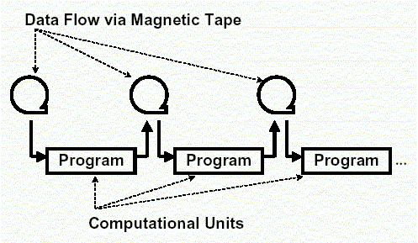
Characteristics of Batch Sequential Systems
Components (processing steps) are independent programs
Connectors are some type of media - traditionally magnetic tape
Each step runs to completion before the next step begins

Slide 10
Characteristics of Batch Sequential Systems
History
Mainframes and magnetic tape
Limited disk space
Block scheduling of CPU processing time
Business data processing
Discrete transactions of predetermined type and occurring at periodic intervals
Creation of periodic reports based on data periodic data updates

Slide 11
Characteristics of Batch Sequential Systems
Transformational data analysis
Raw data is gathered and analyzed in a step-wise, batch-oriented fashion
Typical applications: non real-time, batch oriented computations such as:
Payroll computations
CRA tax return computations

Slide 12
Kinds of Data Flow Architectures
Batch sequential
Dataflow network (pipes&filters)
acyclic, fanout, pipeline, Unix, etc.

Slide 13
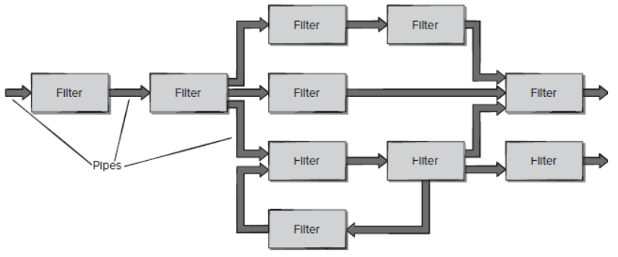
Pipes and Filters
The tape of the batch sequential system, morphed into a language and operating system construct
Compared to the batch-sequential style, data in the pipe&filter style is processed incrementally
Computational Element / filter
Data transfer element / pipe

Slide 14
Pipes and Filters
“The Pipes and Filters architectural pattern [style] provides a structure for systems that process a stream of data. Each processing step is encapsulated in a filter component. Data is passed through pipes between adjacent filters. Recombining filters allows you to build families of related systems.” [POSA p53]

Slide 15
Pipes and Filters
Components (Filters)
Read streams of data on input producing streams of data on output
Local incremental transformation to input stream (e.g., filter, enrich, change representation, etc.)
Data is processed as it arrives, not gathered then processed
Output usually begins before input is consumed
Connectors (Pipes)
Conduits for streams, e.g., first-in-first-out buffer
Transmit outputs from one filter to input of other

Slide 16
Pipes and Filters
Invariants
Filters must be independent, no shared state
Filters don’t know upstream or downstream filter identity
Correctness of output from network must not depend on order in which individual filters provide their incremental processing
Common specializations
Pipelines: linear sequence of filters
Bounded and typed pipes …

Slide 17
Example Pipe-and-Filter Systems
lex/yacc-based compiler (scan, parse, generate code, ..)
Unix pipes
Image processing
Signal processing
Voice and video streaming
…

Slide 18
Data Pulling and Data Pushing
What is the force that makes the data flow?
Four choices:
Push: data source pushes data in a downstream direction
Pull: data sink pulls data from an upstream direction
Push/pull: a filter is actively pulling data from a stream, performing computations, and pushing the data downstream
Passive: don’t do either, act as a sink or source for data
Combinations may be complex and may make the “plumber’s” job more difficult
if more than one filter is pushing/pulling, synchronization is needed

Slide 19
A Push Pipeline With an Active Source
dataSource
push
filter1
push
filter2
push
dataSink
write(data)
f1(data)
write(data)
f2(data)
write(data)

Slide 20
A Pull Pipeline With an Active Sink
dataSink
pull
filter1
pull
filter2
pull
dataSource
data:=read()
data:=read()
data:=read()
f2(data)
f1(data)

Slide 21
A Mixed Push-pull Pipeline With Pasive Source and Sink
dataSink
filter1
pull/push
filter2
pull
dataSource
data:=read()
data:=read()
f2(data)
f1(data)
write(data)

Slide 22
A Pipeline With Active Filters and Synchronizing Buffering Pipes
dataSource
filter1
pull/push
buffering
Pipe
filter2
pull/push
dataSink
data:=read()
f1(data)
data:=read()
write()
data:=read()
f2(data)
f1(data)
write()
write()
data:=read()

Slide 23
Pipe and Filter: Strengths
Overall behaviour is a simple composition of behaviour of individual filters.
Reuse - any two filters can be connected if they agree on that data format that is transmitted.
Ease of maintenance - filters can be added or replaced.
Prototyping e.g. Unix shell scripts are famously powerful and flexible, using filters such as sed and awk.
Architecture supports formal analysis - throughput and deadlock detection.
Potential for parallelism - filters implemented as separate tasks, consuming and producing data incrementally.

Slide 24
Pipe and Filter: Weaknesses
Can degenerate to ‘batch processing’ - filter processes all of its data before passing on (rather than incrementally).
Sharing global data is expensive or limiting.
Can be difficult to design incremental filters.
Not appropriate for interactive applications - doesn’t split into sequential stages. POSA book has specific styles for interactive systems, one of which is Model-View-Controller.
Synchronisation of streams will constrain architecture.
Error handling is Achilles heel e.g. filter has consumed three quarters of its input and produced half its output and some intermediate filter crashes! Generally restart pipeline. (POSA)
Implementation may force lowest common denominator on data transmission e.g. Unix scripts everything is ASCII.

Slide 25
Pipe-and-Filter vs. Batch Sequential
Both decompose the task into a fixed sequence of computations (components) interacting only through data passed from one to another
Batch Sequential | Pipe-and-Filter
course grained high latency external access to input no concurrency non-interactive | fine grained results starts processing localized input concurrency possible interactive awkward but possible

Slide 26
Your Turn
Provide examples of two applications which are suitable using the pipes and filters architecture and explain how the architecture is used. Do the same for two applications which are suitable using the batch sequential architecture
Explain the difference between a pull filter and a push filter in the pipes and filters architecture.
Explain the statements a) “Reuse - any two filters can be connected if they agree on that data format that is transmitted” and b) “Architecture supports formal analysis - throughput and deadlock detection“, pertaining the pipes and filters architecture.
Check-out the content of the following sites:
https://docs.microsoft.com/en-us/azure/architecture/patterns/pipes-and-filters
https://www.tutorialspoint.com/software_architecture_design/data_flow_architecture.htm

